Slide 1
Interfacing with the Analog World

Slide 2
outline
11: Digital to analog conversion (DAC), D/A conversion circuitry, Summing amplifier, Analog to digital conversion (ADC), A/D conversion circuitry, Digital ramp ADC
12: Memory Devices: Memory terminology, general memory operation, semiconductor memory technologies, different types of ROMs, semiconductor RAMs, static and dynamic RAMs, ROM architecture, RAM architecture, FPGA Concept.

Slide 3
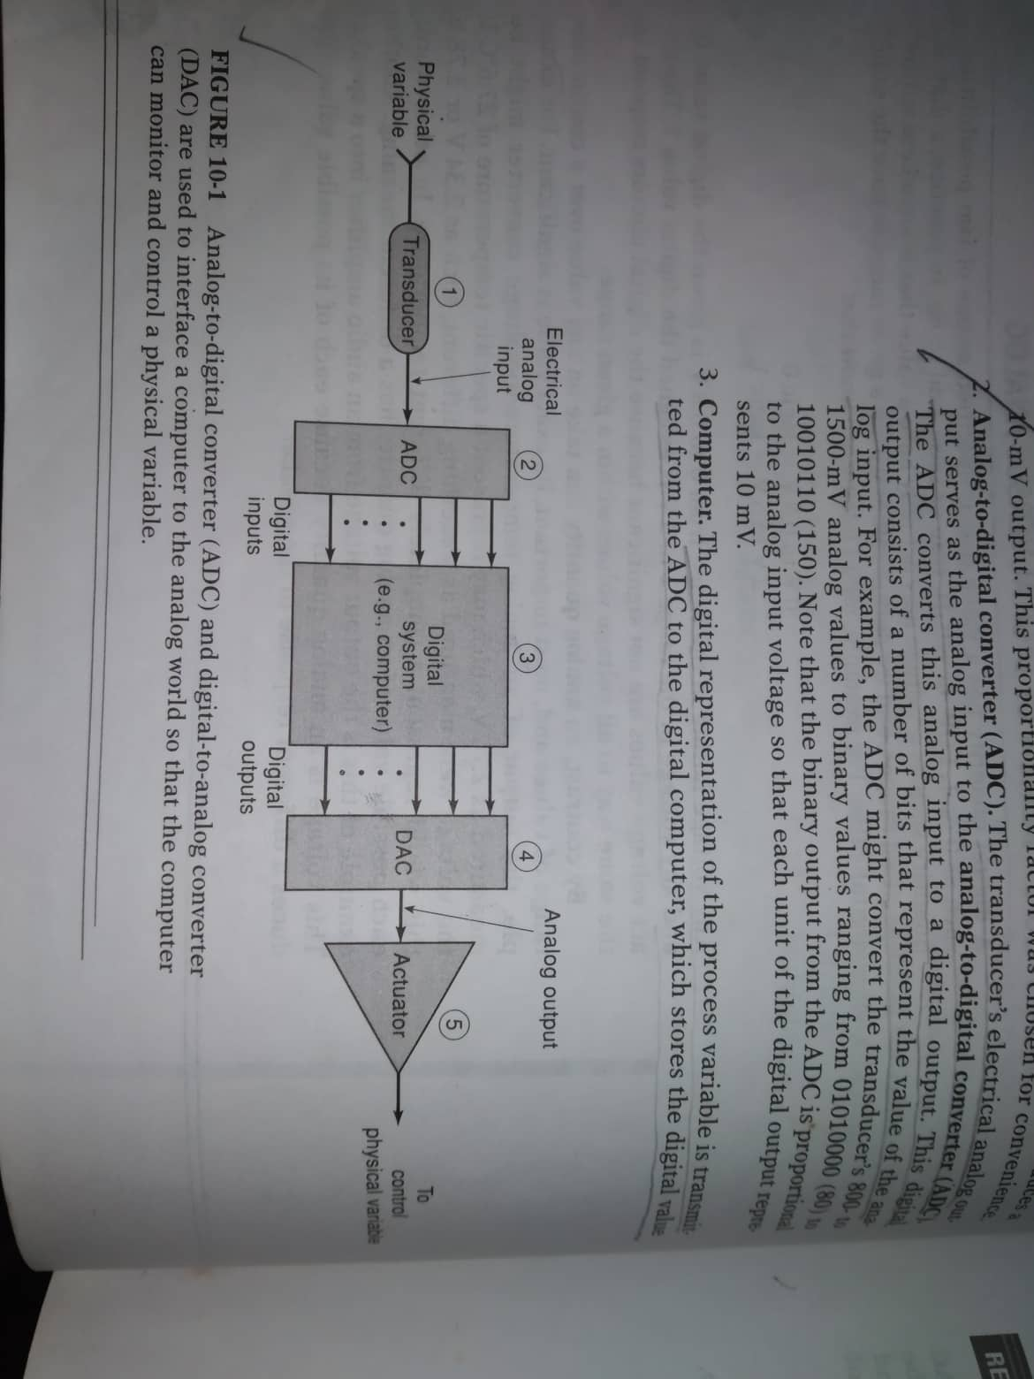
ADC-DAC

Slide 4
ADC-DAC
Transducer
Analog to digital converter
Computer
Digital to analog converter
Actuator

Slide 5
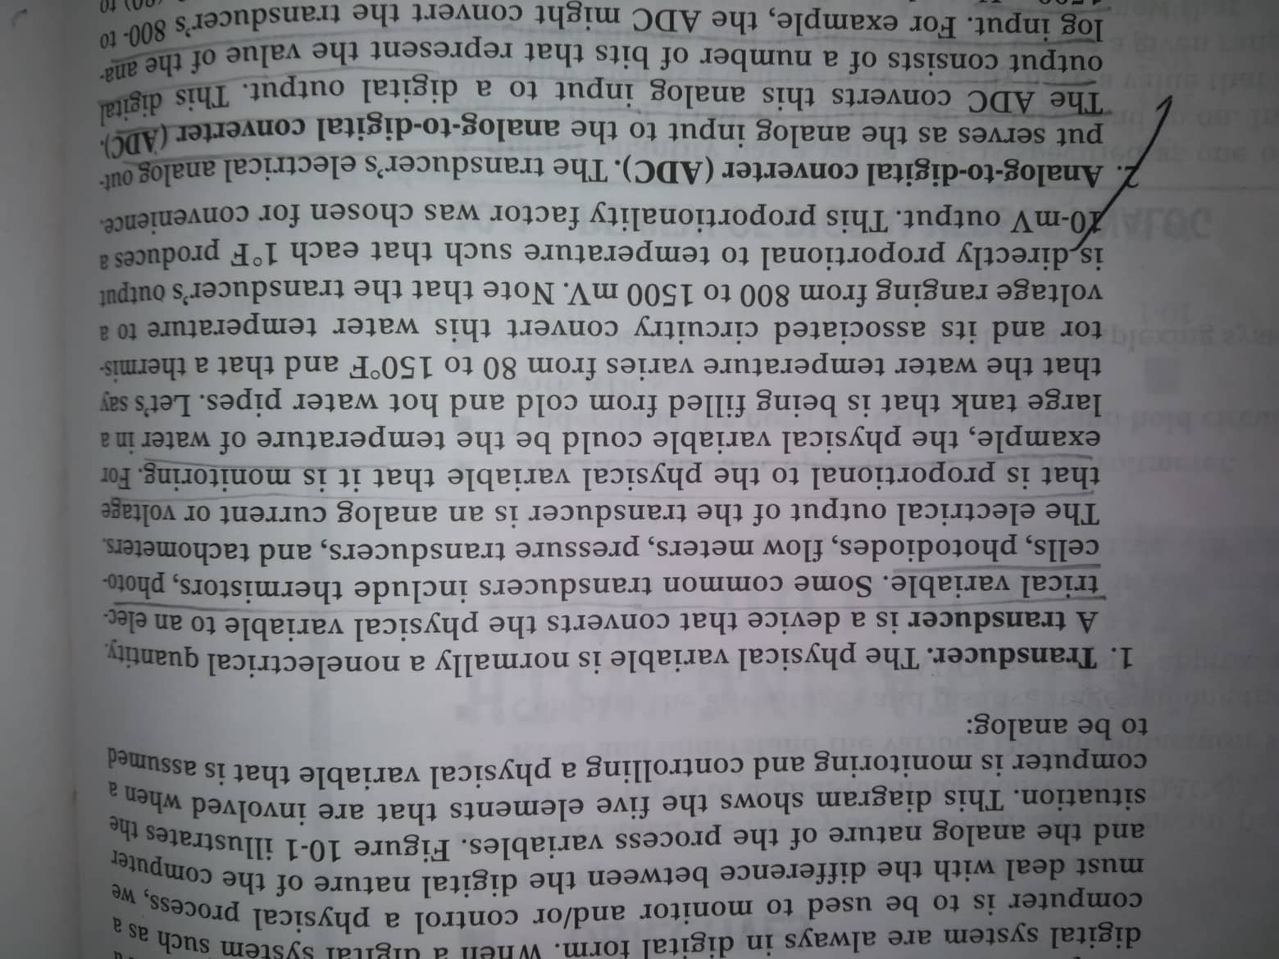
Transducer

Slide 6
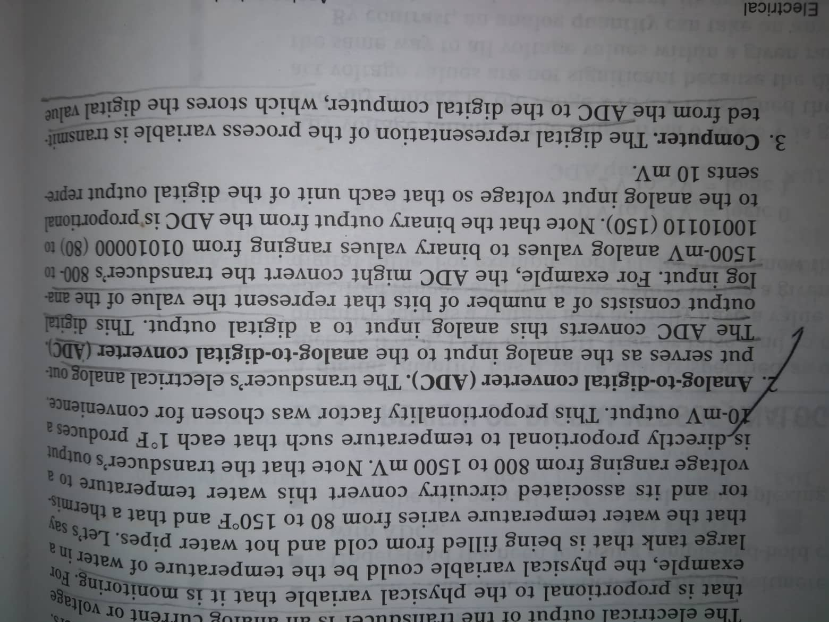
ADC- Digital computer

Slide 7
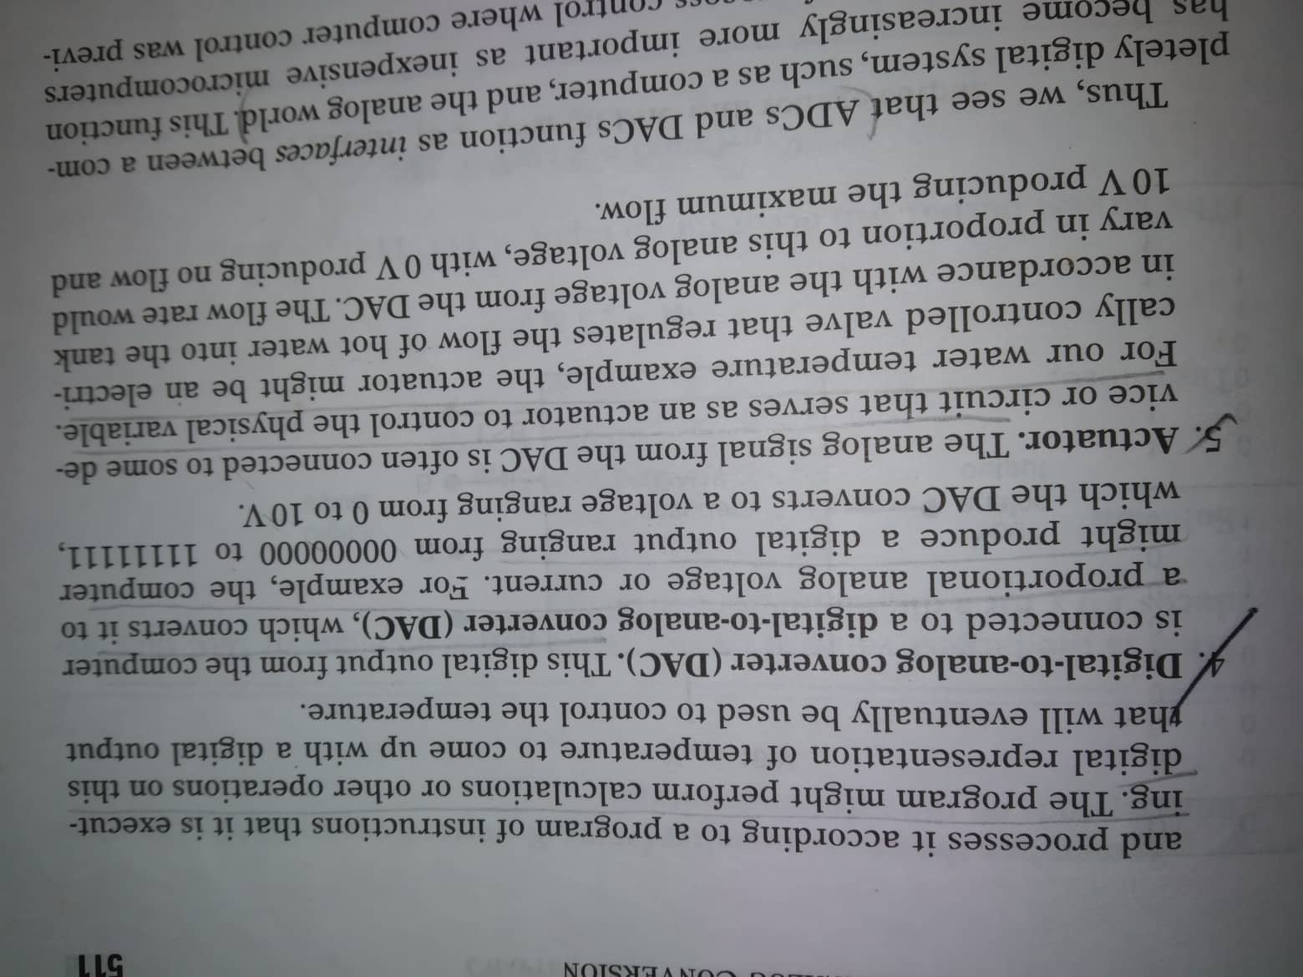
DAC-actuator

Slide 8
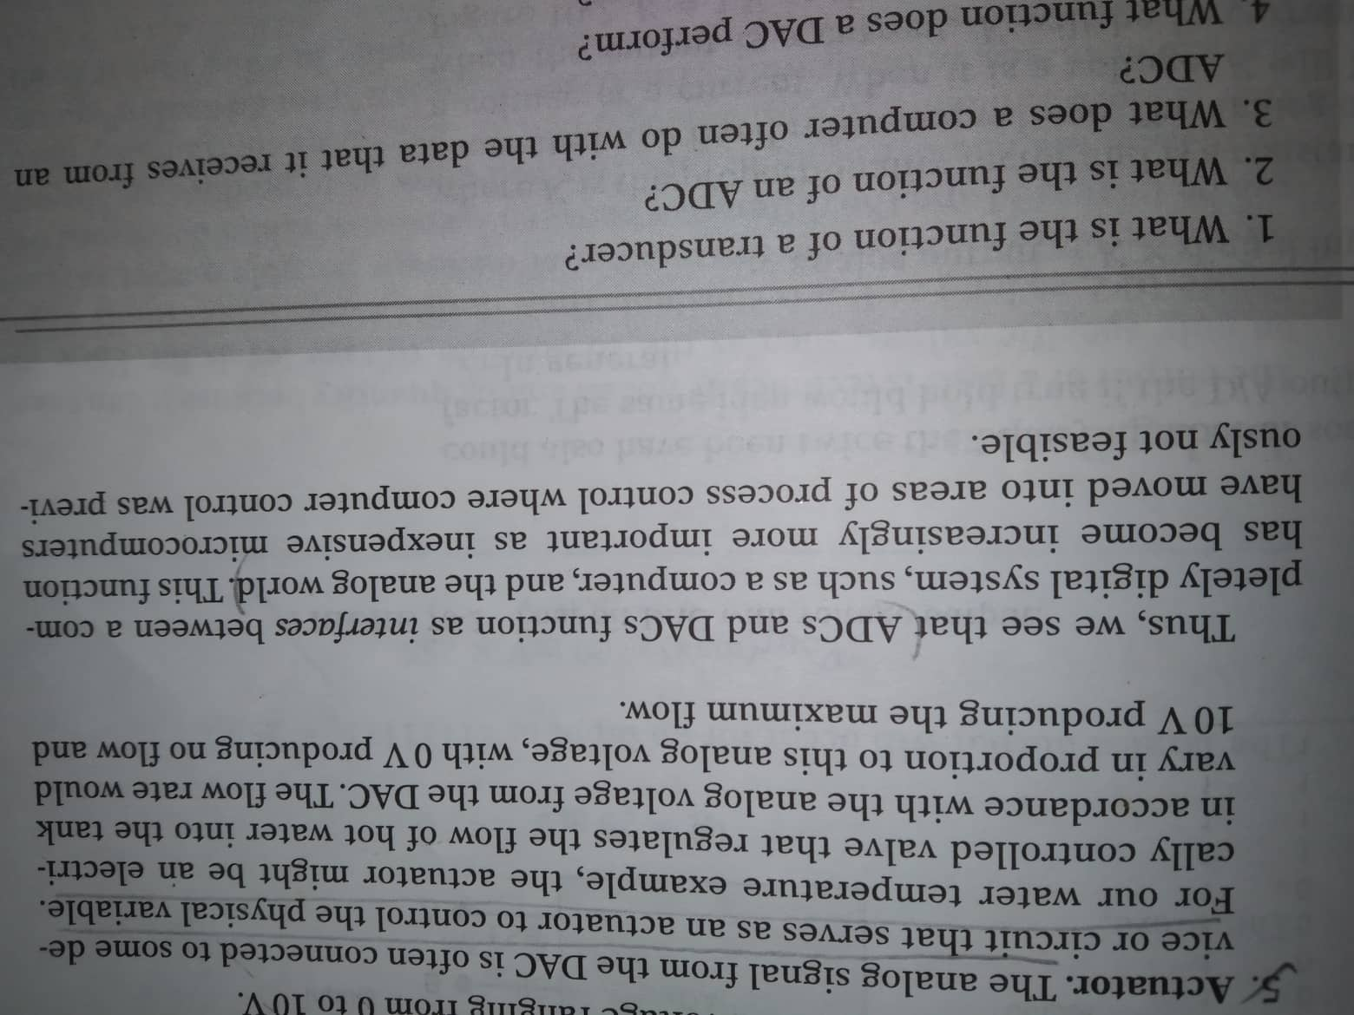
ADC-dac

Slide 9
Digital-to-analog conversion

Slide 10
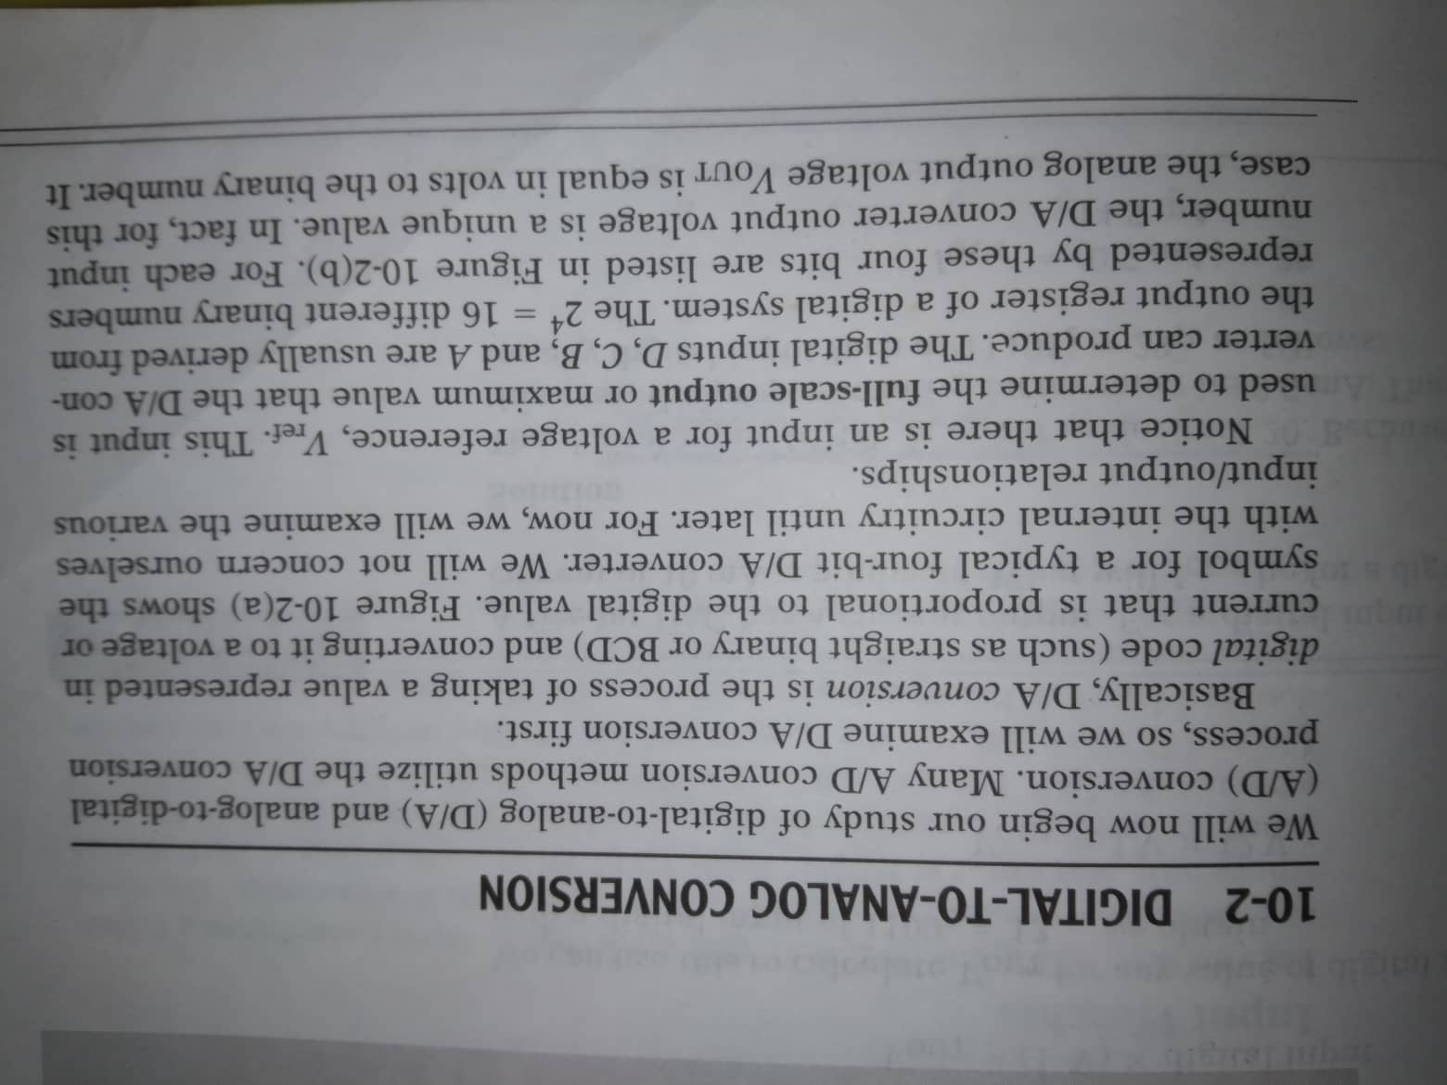
Digital-to-analog conversion (4-bit dac)

Slide 11
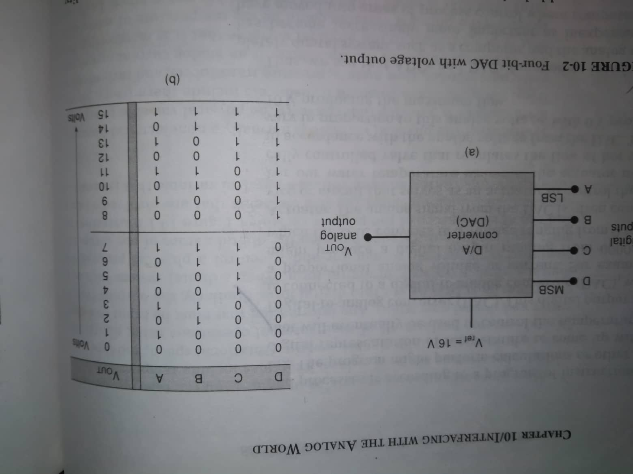
Digital-to-analog conversion (4-bit dac)
15V

Slide 12
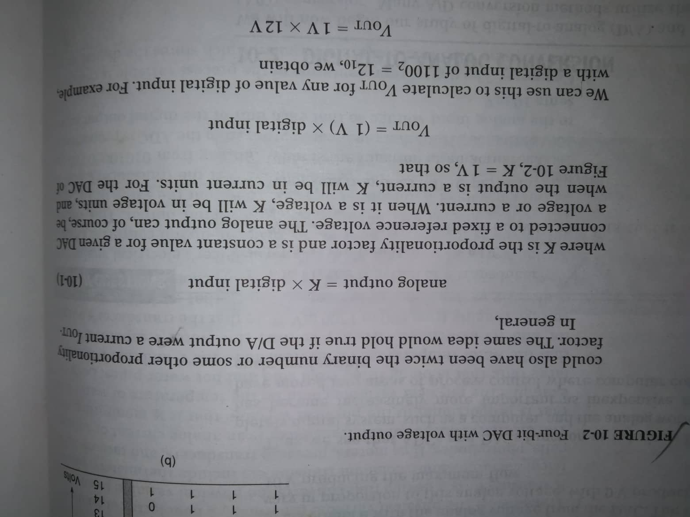
Digital-to-analog conversion (4-bit dac)

Slide 13
Problem-solution
A 5-bit DAC has a current output. For a digital input of 10100, an output current of 10 mA is produced. What will I_{OUT} be for a digital input of 11101?

Slide 14
Problem-solution
A 5-bit DAC has a current output. For a digital input of 10100, an output current of 10 mA is produced. What will I_{OUT} be for a digital input of 11101?
Solution: 10100₂= 20₁₀
I_{OUT} =10 mA
Proportionality factor= 0.5 mA
[K=10mA/20=0.5mA or 20×0.5mA=10 mA]
Now, 11101₂=29₁₀
I_{OUT}= 29×0.5= 14.5 mA

Slide 15
Problem-solution
What is the largest value of output voltage from an 8-bit DAC that produces 1.0 V for a digital input of 00110010?

Slide 16
Problem-solution
What is the largest value of output voltage from an 8-bit DAC that produces 1.0 V for a digital input of 00110010?
Solution: 00110010₂= 50₁₀
1V=K×50
K= 1V/50=0.02V= 20 mV
The largest output will occur for an input of 11111111₂=255₁₀
Now, 11101₂=29₁₀
V_{OUT}= 20 mV×255
= 5.10 V.

Slide 17
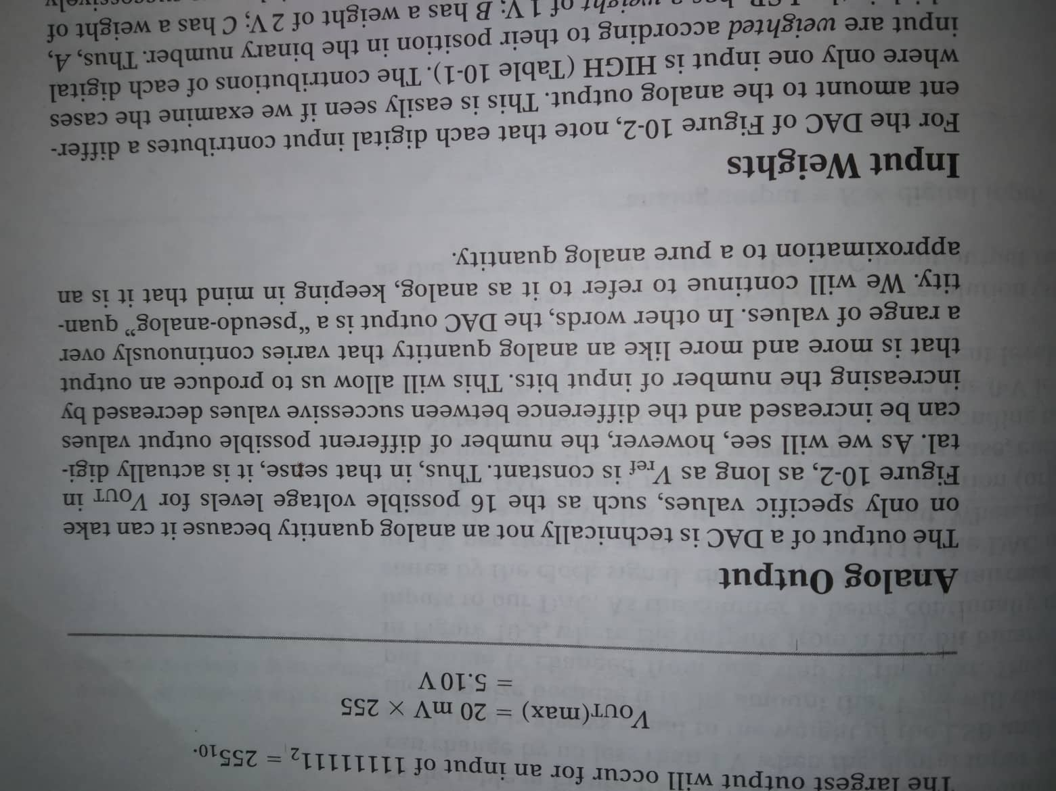
Analog output

Slide 18
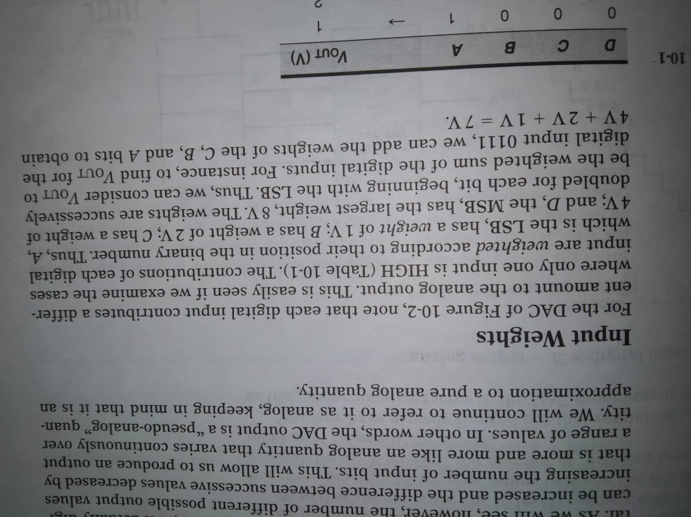
Input weights

Slide 19
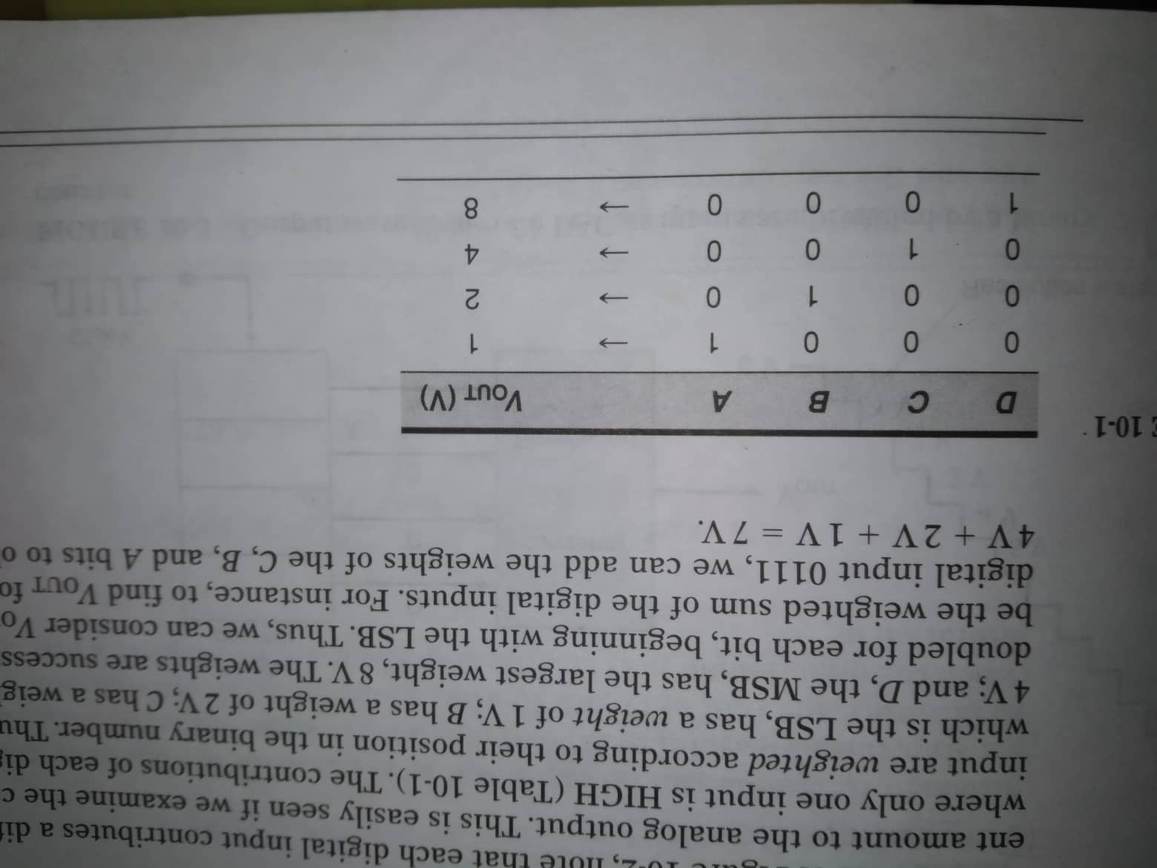
Input weights

Slide 20
Problem-solution
A 5-bit DAC produces V_{OUT}=0.2V for a digital input of 00001. Find the value of V_{OUT} for an input of 11111.

Slide 21
Problem-solution
A 5-bit DAC produces V_{OUT}=0.2V for a digital input of 00001. Find the value of V_{OUT} for an input of 11111.
Solution: 0.2V is the weight of the LSB. Then the weights of other bits must be 0.4V, 0.8V, 1.6V, 3.2 V respectively.
For digital input 11111, the value of
V_{OUT}= 3.2V+1.6V+0.8V+0.4V+0.2V=6.2V.

Slide 22
D/A converter circuitry

Slide 23
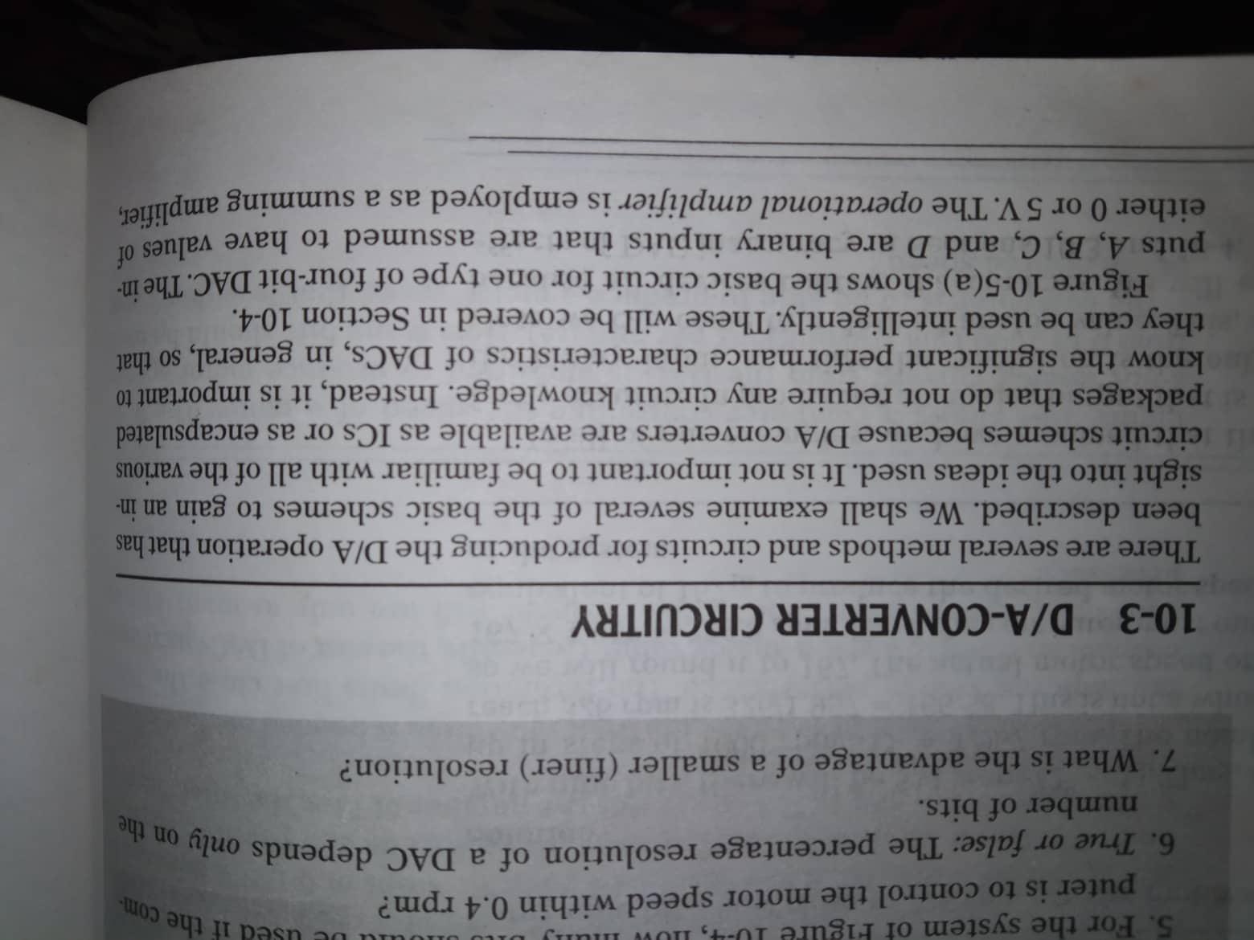
D/A converter circuitry

Slide 24
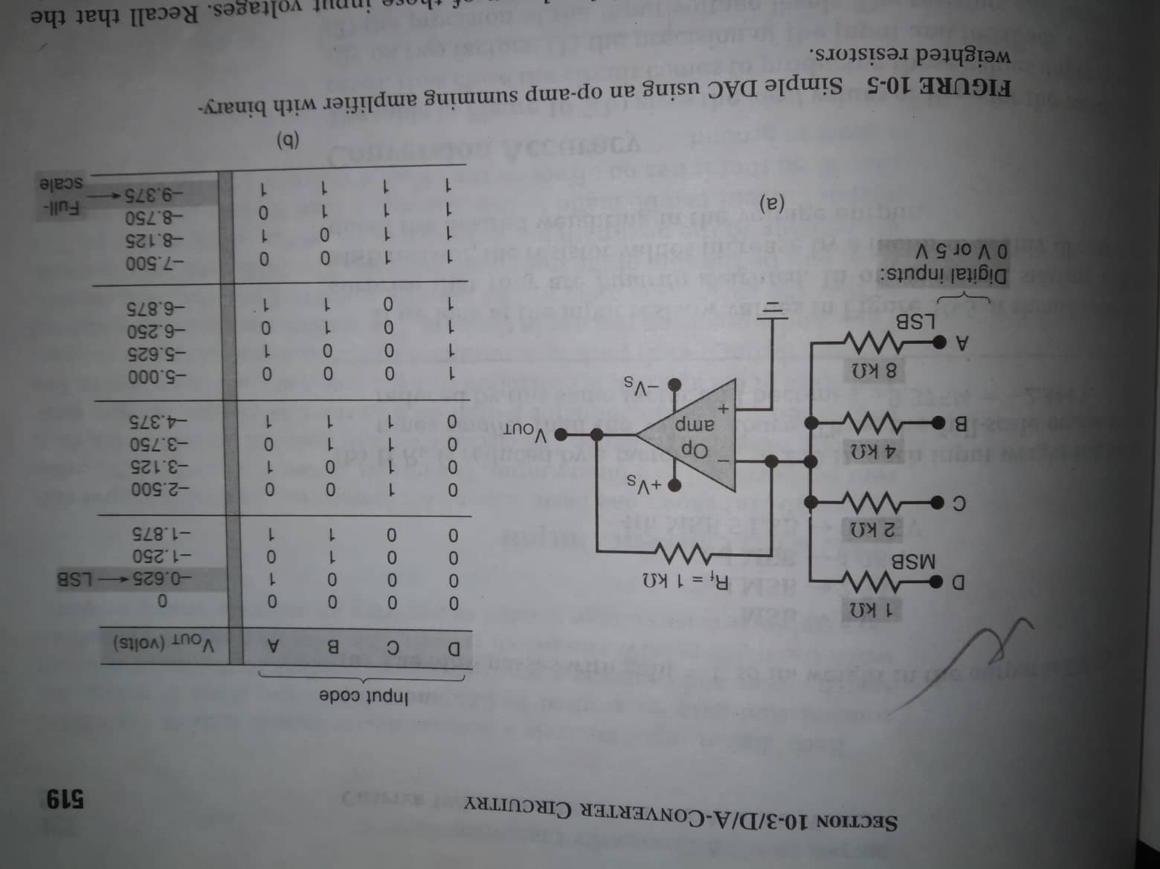
Dac using an op-amp summing amplifier
5V/8= 0.625 V
R_{IN}
R_{f}/R_{IN}

Slide 25
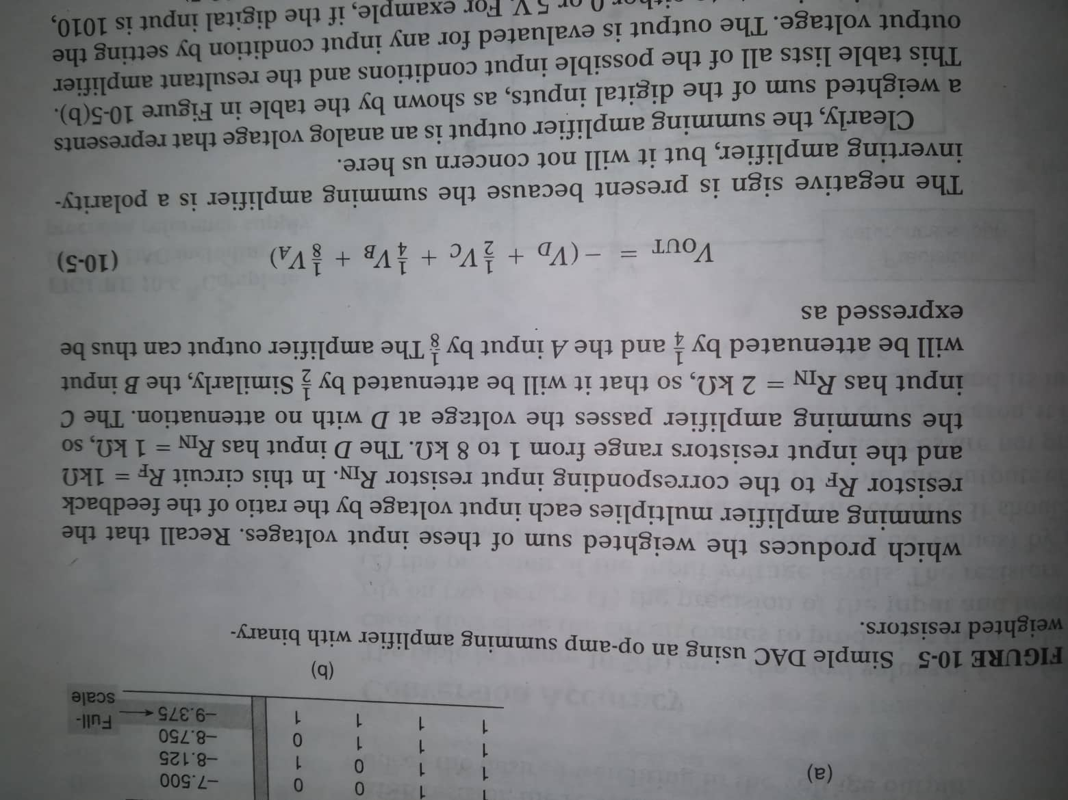
Dac using an op-amp summing amplifier

Slide 26
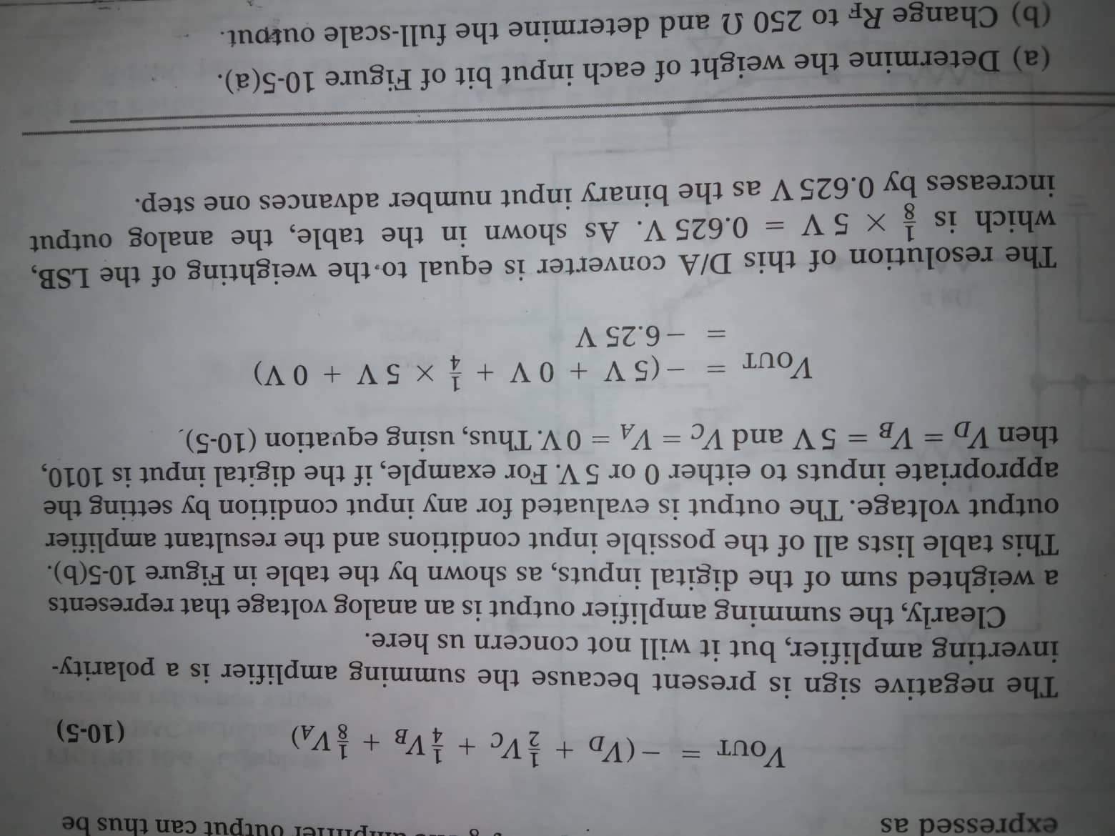
Dac using an op-amp summing amplifier

Slide 27
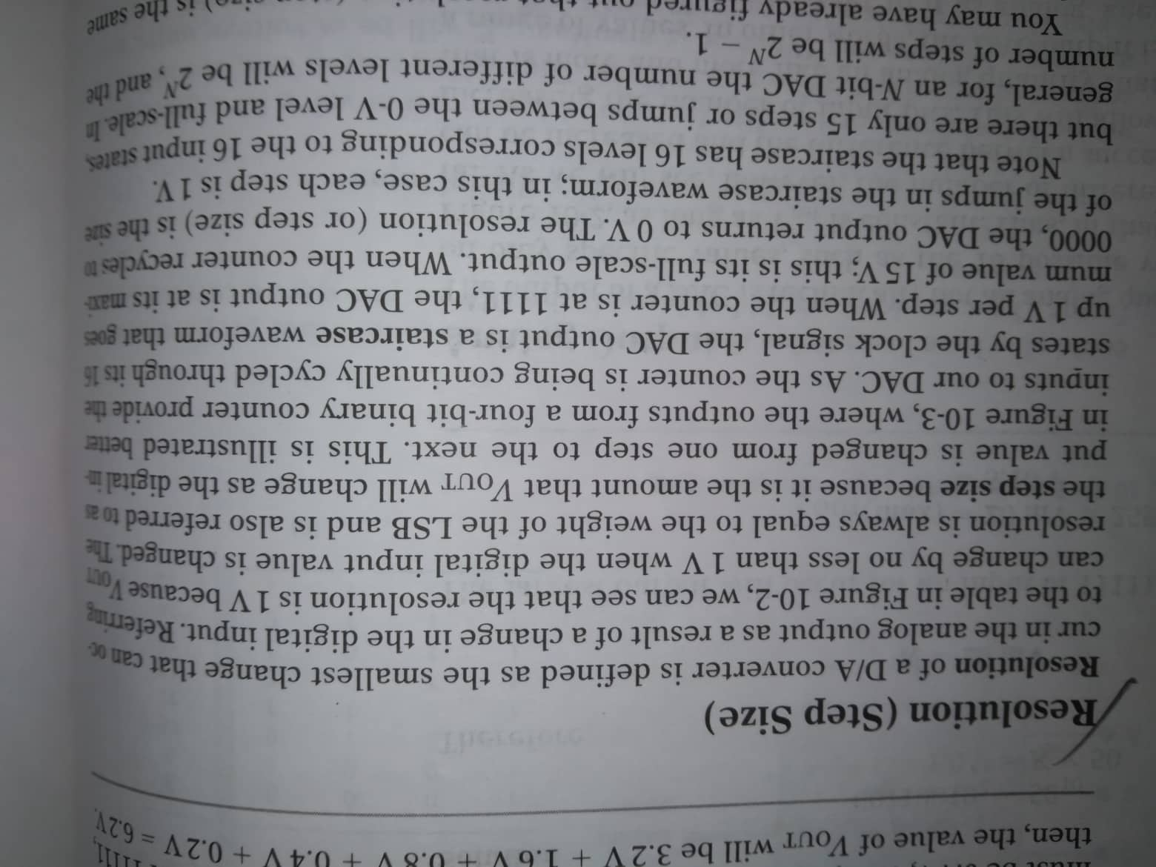
Resolution (step size)

Slide 28
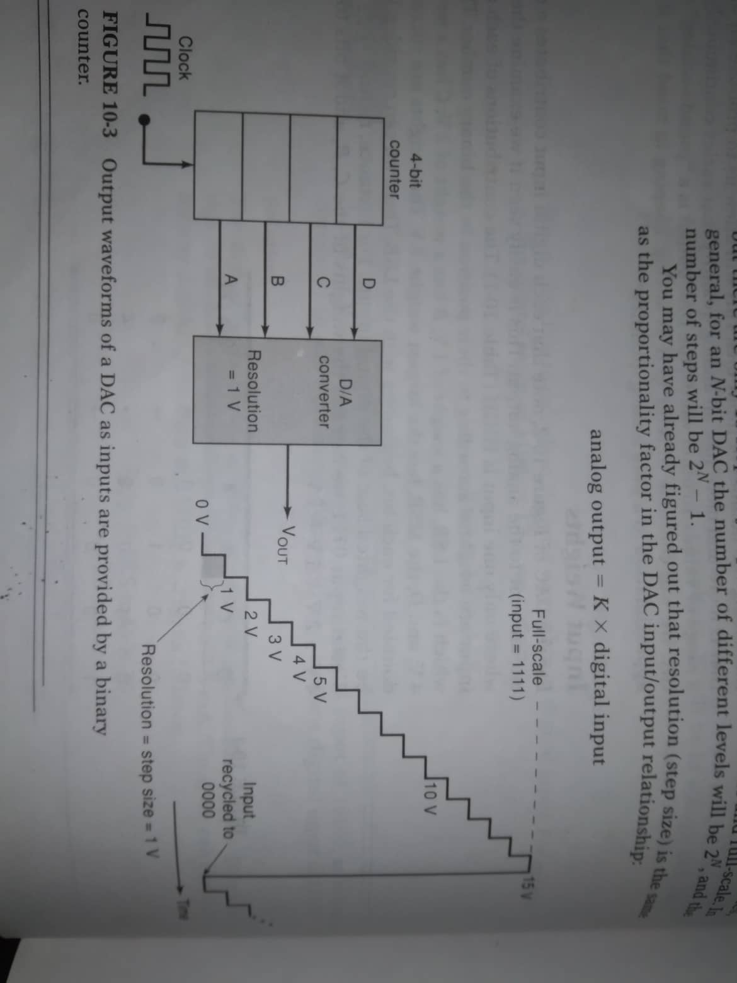
Resolution (step size)

Slide 29
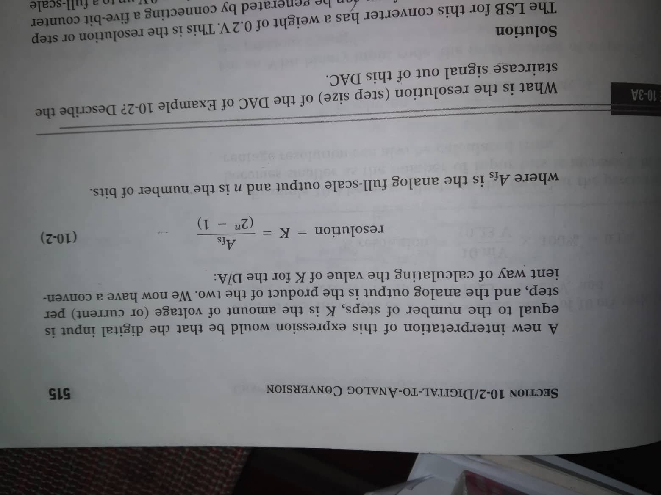
resolution

Slide 30
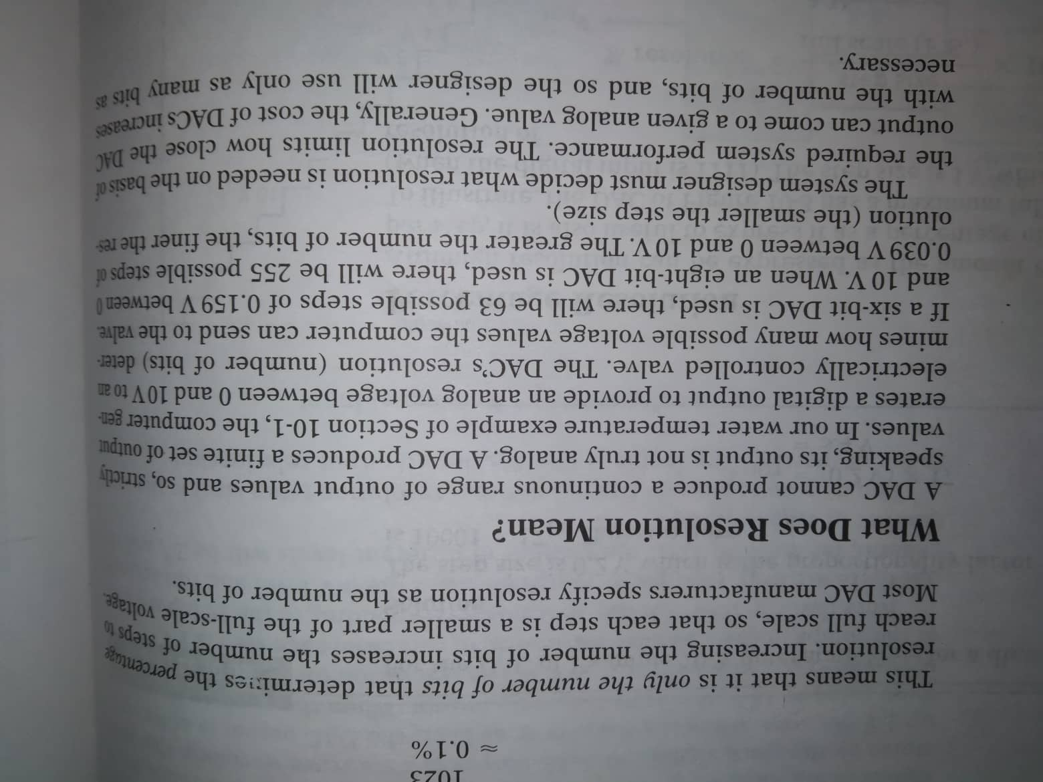
resolution

Slide 31
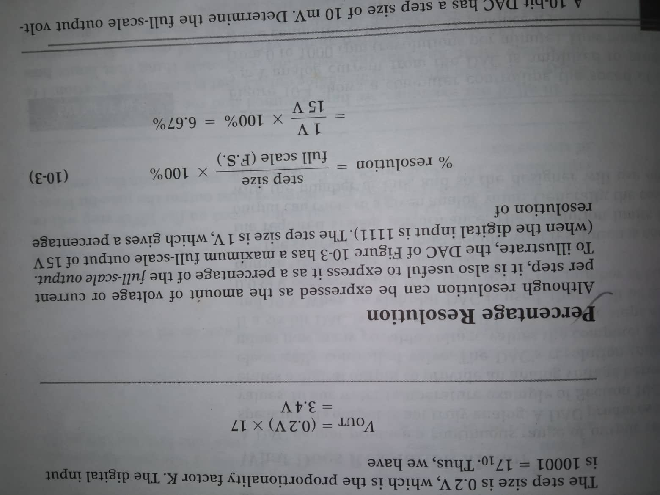
Percentage resolution

Slide 32
Problem-solution
A 10-bit DAC has a step size of 10mV. Determine the full scale output voltage and the percentage resolution.

Slide 33
Problem-solution
A 10-bit DAC has a step size of 10mV. Determine the full scale output voltage and the percentage resolution.
Solution: No. of steps= 2¹⁰-1=1023 steps of 10mV each.
So the full scale output= 10mV×1023= 10.23V
%resolution= 10mV/10.23V × 100% = 0.1%

